Slide 1
Tula Metal Rolling Plant

Slide 2
About the plant
Tula Metal Rolling Plant has been manufacturing quality steel products since 2007. The production process is organised in accordance with ISO9001-2015 quality management requirements.
TMRP is located 160 km from Moscow. It is a unique investment project implemented in the Proletarsky district of Tula between 2008 and 2013.
Area of production facilities more than 62000 m²
Availability of railway access roads and its own station Tula-Vyazemskaya
The company’s turnover is €75 mln per year

Slide 3
Our advantages
Guarantee of high quality
Customised production possibilities
Staying in touch with the customer at all time
Extensive supply experience
Immediate solution to all possible problems
Product uniqueness
Wide range of products

Slide 4
Range of products
Rebar with a four-row thread bar
Thread bar
Formwork tie
Self-expandable ground anchor
Anchor
Steel bar
Reinforcing bar
Round steel bar
Structural steel design

Slide 6
Thread bar for reinforced concrete
The thread bar for reinforced concrete is connected by means of a coupler with locknuts, which are screwed in with a fixed torque and ensure the strength of the connection.
Thread bar diameter: 15, 16, 18, 20, 22, 25, 26, 5, 32, 36, 40 mm
1
2
3
1
2
3
Rolled class: А-III (A400), A500, A600, Aт800, Ат 1000
1 – thread tie rod
2 – locknuts
3 – coupler
Steel grade: 25Г2С, steel 3
Steel grades are specified by Russian Standards

Slide 7
Formwork tie
Formwork tie is used to join the formwork panels together, to achieve the designed thickness and to take the static and dynamic loads of the concrete mix.
Thread bar diameter: 15, 20, 25 mm
Rolled class: 600/880, 800/1000
Steel grade: steel 80, 25Г2С
Steel grades are specified by Russian Standards

Slide 8
Self-expandable ground anchor
Self-expandable ground anchor is a self-expanding anchor that is loaded with impact force and mainly takes up the pulling force.
Thread bar diameter: 16, 20 mm
1 – thread tie rod
2 – outer support
3 – self-expandable ground anchor
4 – spherical nut
5 – domed washer
6 – coupler
Shear stress: 1-12 tonnes
Installation depth: 2-12 m

Slide 9
Expansion shell rock anchor
Expansion shell rock anchors are used to anchor main and preparatory mine workings in coal and salt mines, potash mines as well as other mining enterprises.
Thread bar diameter: 15, 16, 20, 22, 25 mm
Rolled class: А400, А500
1 – thread tie rod
2 – dome nut
3 – domed washer
4 – expansion unit
Steel grade: steel 80, 25Г2С
Steel grades are specified by Russian Standards

Slide 10
Anchor rods
Anchor rods are used for anchoring the face walls of seaports and river ports, dams, dikes and other reinforcing structures.
Thread bar diameter: 25 mm
Rolled class: Aт800
Steel grade: 25Г2С
Steel grades are specified by Russian Standards

Slide 11
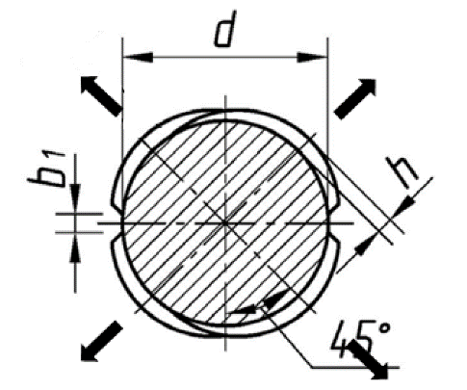
Арматура нового поколения с четырёхрядным винтовым профилем
Rebar with a four-row thread bar
!
Экономит объем армирования ж/б конструкций до 30%
Сокращает время стыкования арматуры в 2$/$10 раз
Повышает безопасность и эффективность эксплуатации объектов строительства
!!!
The cross ribs of the four-row screw reinforcement form a double-stranded thread along its entire length, providing twice the screwing speed of fasteners such as couplers, anchor nuts.
Сокращает численность и снижает требования к квалификации рабочего персонала. Исключает затраты на покупку дополнительного оборудования.
Сохраняет геометрическую ось, по длине арматурного стержня. Гарантирует равнопрочный стык и постоянный коэффицент армирования. Обеспечивает высокую анкерующую способность и трещиностойкость в бетоне.
Обеспечивает выполнение требований зарубежных и новых российских нормативных документов СП 63.13330-2012 и ГОСТ 34028-2016.
Внедрение высокоэффективной арматуры с четырехрядным винтовым профилем позволяет обеспечить высокую эффективность проектирования и строительства из железобетона.
Thread bar diameter:
12 ÷ 36 mm
Двухсторонний двухрядный
Четырёхсторонний
шестирядный
Четырёхсторонний четырехрядный
винтовой
Кольцевой
Rolled steel grade:
Av500P and Av600P
Steel grade:
25G2S

Slide 12
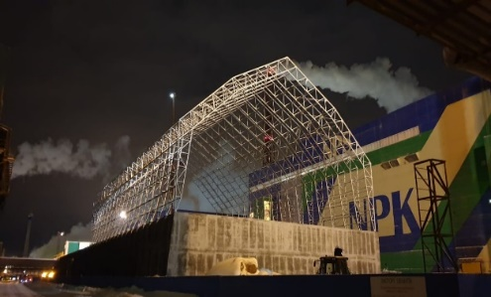
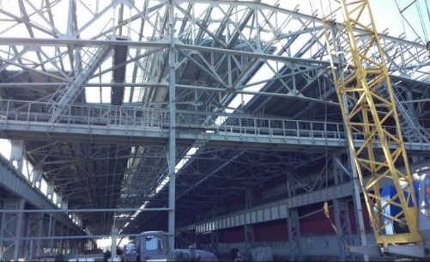
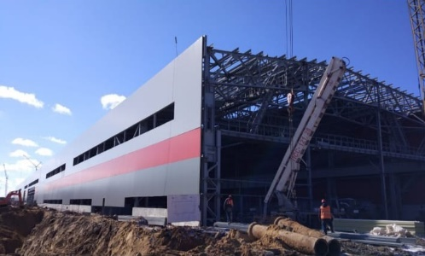
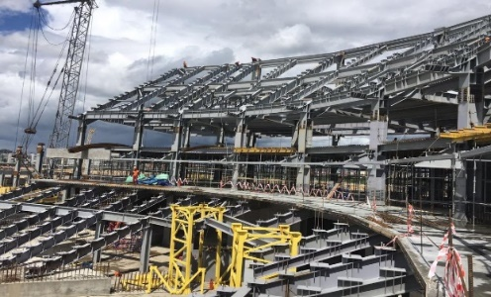
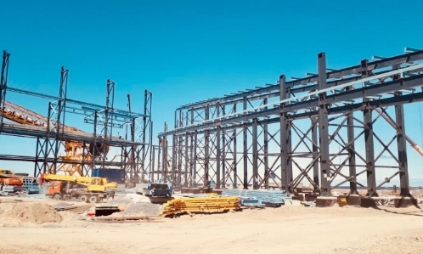
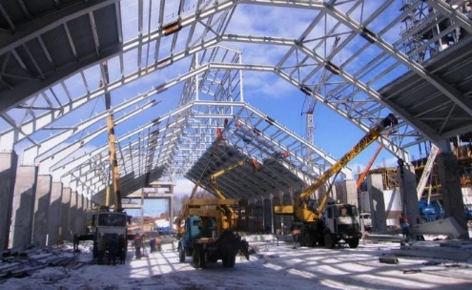
Our projects
Mineral fertiliser warehouse in г. Cherepovets. Construction of a chemical fertiliser warehouse. 360 tonnes
Oskol Electrometallurgical Plant
(Rolled steel processing shop)
Belgorod region, Oskol
3,380 tonnes
Oskol Electrometallurgical Plant
(Rolled steel processing shop)
Belgorod Region, Oskol.
3,380 tonnes
Football stadium for the 2018 World Cup in Kaliningrad.
Construction of reinforced concrete foundations and footings.
1,200 tonnes
Port conveyor gallery in Vistino, Leningrad region.
2,000 tonnes
Production facilities for the ‘Tulacement’ cement plant
(Heidelberg Group)
1200 tons

Slide 13
Our partners

Slide 14
Our contacts
Office: 21/1 Sadovaya-Spasskaya Street, Moscow
Production: 31 Shcheglovskaya Zaseka Street, Tula
Tel.: +7(495)419-00-78
Email: info@tigk.ru
shubenkoea@tigk.ru Shubenko Evgenii
lyskovda@tigk.ru Lyskov Daniil

